Slide 1

Petroleum Technology Association of Nigeria (PETAN)
Presented at the NAMIBIA OIL & GAS CONFERENCE
16 -17 AUGUST 2023
Nigerian local content policy & practice
ASSOCIATION PERSPECTIVE/COLLABORATIVE APPROACH
By
Mr. Ranti Omole
Vice Chairman, Petroleum Technology Association of Nigeria (PETAN)

Slide 2
Outline
Introduction
Strategic Objectives
Range of Services
Technology Interest Groups (TIGs)
Local Content from Association’s perspective
Collaborative Approach
Conclusion

Slide 3
Introduction
PETAN - an association of leading Nigerian Indigenous Technical Oilfield service companies supporting the upstream, midstream, and downstream sectors of the oil & gas industry
Formed in 1990, the association was created to bring together Nigerian Oil & Gas entrepreneurs and to create a forum for the exchange of ideas with the major operators, industry stakeholders and policy makers.
PETAN membership comprises over 100 service companies involved across the entire value chain of upstream, midstream and downstream subsectors of the oil and gas industry.

Slide 4
Introduction
In collaboration with other stakeholders such as Nigerian Content Monitoring and Development Board (NCDMB) , Nigerian National Petroleum Company (NNPC Limited), National Assembly, Oil Producers Trade Section of LCC&I (OPTS), Oil and Gas Trainers Association (OGTAN) , PETAN has grown over the years to be a leading advocacy group and technology service providers association.
Since inception, PETAN has been on the path of promoting the development of the oil and gas industry in Nigeria through the organization and participation of Nigerian Entrepreneurs in local and international conferences, seminars, workshops, and creating opportunities for Nigerian companies to project themselves in the competitive industry –Offshore Technology Conference (OTC) – African Pavilion, & Sub-Saharan African International Petroleum Exhibition & Conference (SAIPEC )

Slide 5
Strategic OBJECTIVES
Continue to be leading advocate for Local Content Development in Nigeria and Africa - enabling business environment
Continue capacity development, technology domestication and human capital development –PETAN/NCDMB/Shell Internship, NCCF Initiative on Human Capital – partnership.
Service Quality Enhancement and Certification – PETAN Seal of Quality /NCDMB- African Seal of Quality
Collaboration within Nigeria and the African Region for capacity development and experience leverage with Regulators , National Oil companies and Service Providers Associations
- Facilitate development of business , operational and collaboration framework in African Region (end to end)
Support the development of local content policies in African countries to enhance indigenous participation.
Continue to support and grow SAIPEC into African Region Capacity development & collaboration marketplace
Trade Missions to other emerging African Oil and Gas Frontiers – NAMIBIA , Tanzania, Uganda, Senegal, Ghana, Mozambique

Slide 6
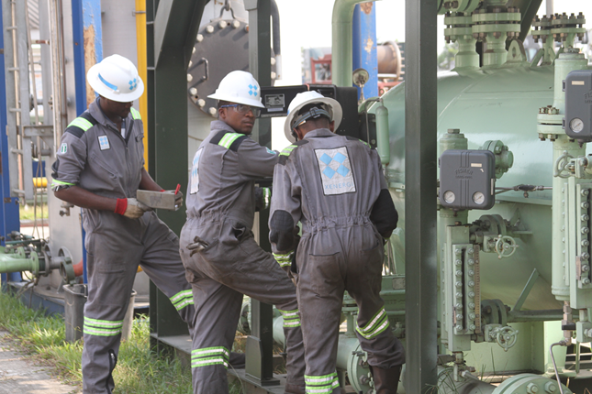
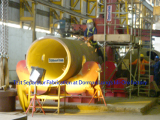
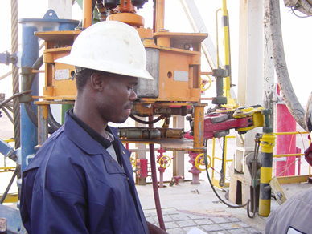
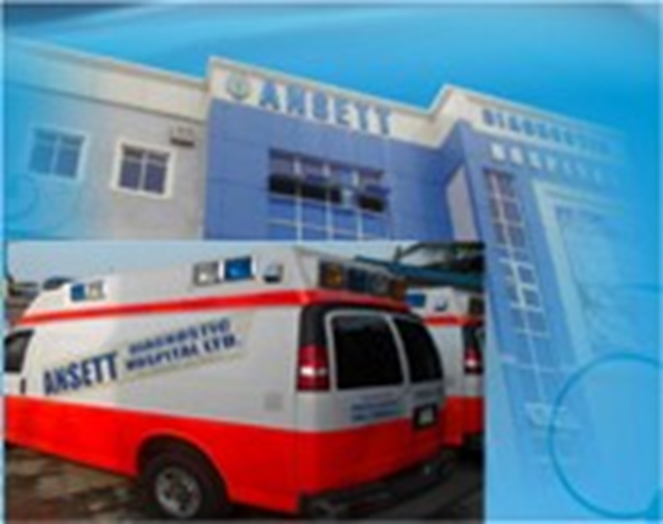



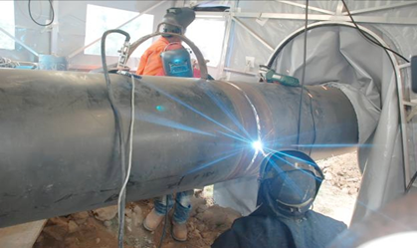
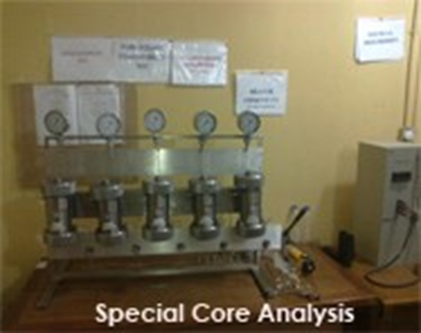

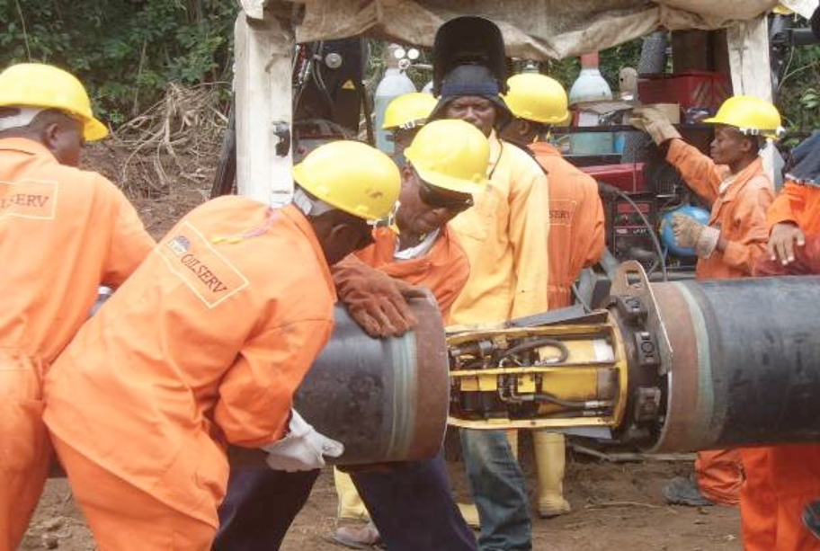
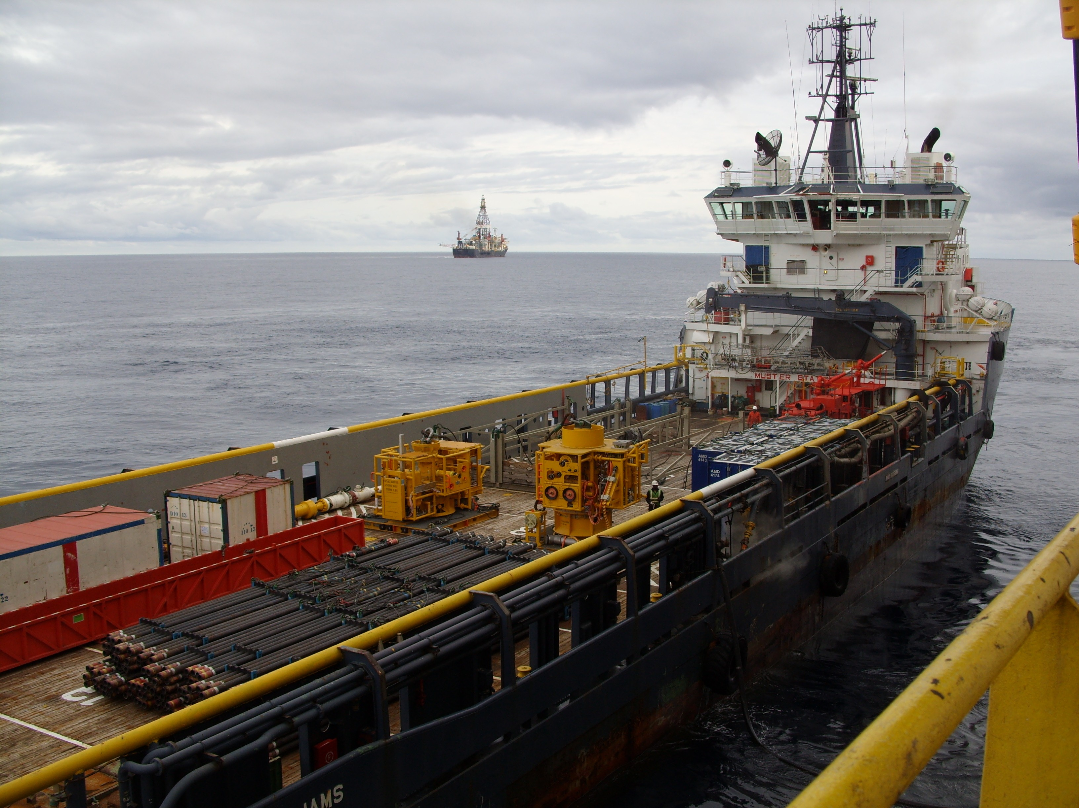
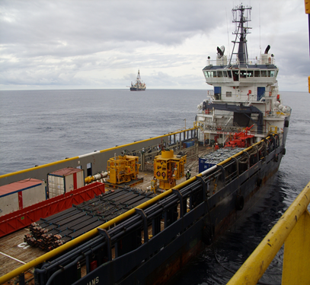
Our Wide Spectrum Capabilities
Drilling, Completions & Well Services
Fabrications and Manufacturing
Management Information Systems
EPCI- Projects, Construction, Installations
Pipelines, Facilities and Process Systems
Production & Operations
Reservoir. Geophysics & Geosciences
Training & Human Development
Safety Systems & Certifications
Project Management
Offshore Services and Vessels
Engineering Design, FEED, Detailed Etc.
Electrical, Mechanical & Instrumentation

Slide 7
TECHNOLOGY INTEREST GROUPS ( TIG)
We have, over the years, developed and positioned ourselves to take on and execute projects of various types in the industry.
This end, we are categorised into 13 various groups called “Technology Interest Groups”:

Slide 8
Local Content
Promotion of Local Content in O &G- catalyst for economic development and wealth creation.
Best business practice for profitability and cost effectiveness
Tool for domestic capacity development and domestication of technology.
Program for creating local technical employment and competence.
Investment driver in facilities and human capital development.
A business model to be supported by each government in Africa .
Incentives for local service providers to invest and grow their businesses.
Government to encourage and ensure implementation through appropriate Local Content Development and Monitoring Board.

Slide 9
COLLABORATIVE APPROACH
PETAN is currently leading the discourse on Local Content in Africa through partnership and engagement via SAIPEC initiated African Local Content Collaboration Steering Committee and with related associations such as
ACLM - Mozambique Local Content Association -2022
ATOGS - Association of Tanzania Oil and Gas Service Providers
GOGSPA - Ghana Oil and Gas Service Providers Association
AUOGS – Association of Uganda Oil & Gas Service Providers
. AECIPA – Angola Oil and Gas Service Companies Association
ASCL – Senegalese Association for Local Content Empowerment & Development (Association Senegalaise Du Contenu Local) - 2023
Other African Service Companies Associations – Namibia ??

Slide 10
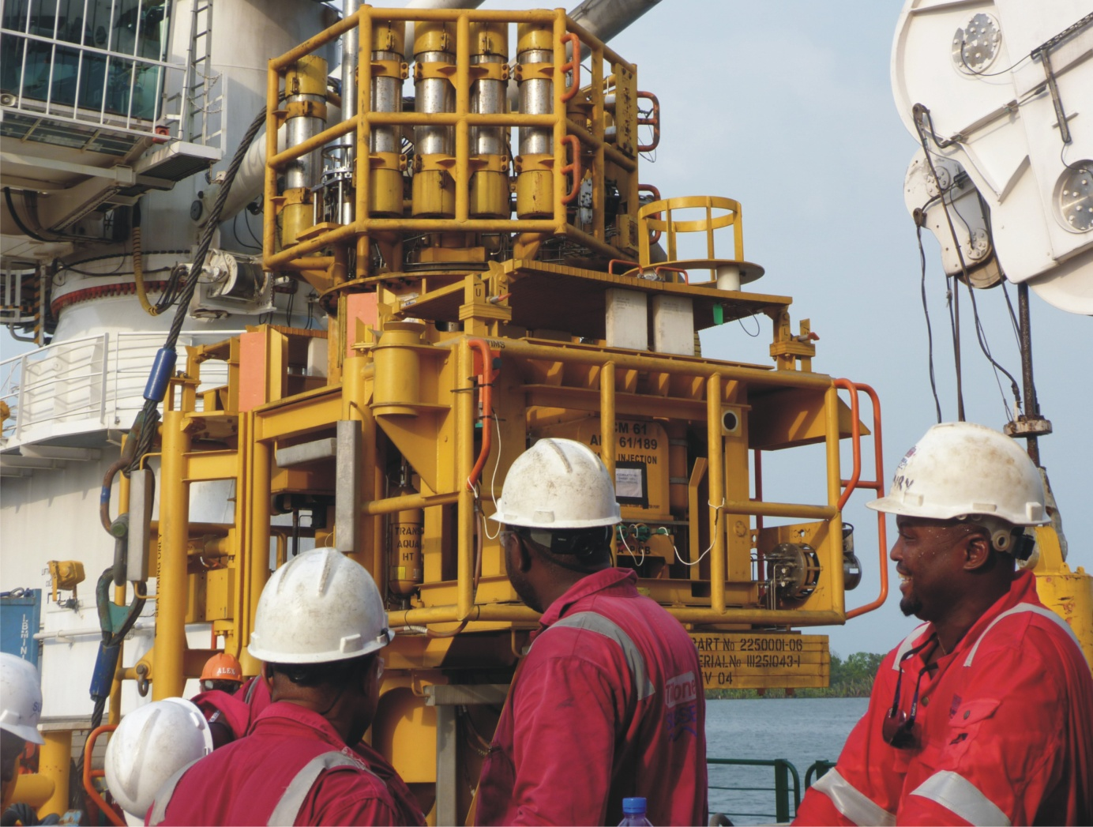
Subsea Rigging and Deployment

Slide 11
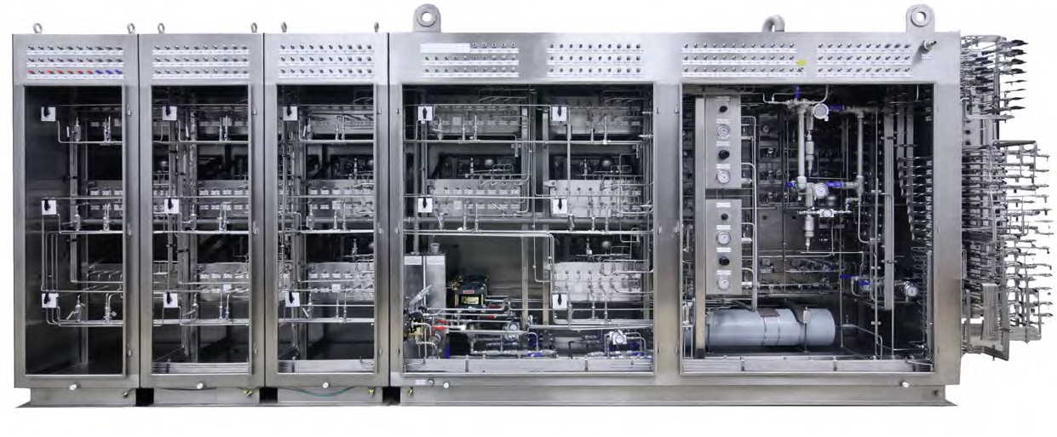
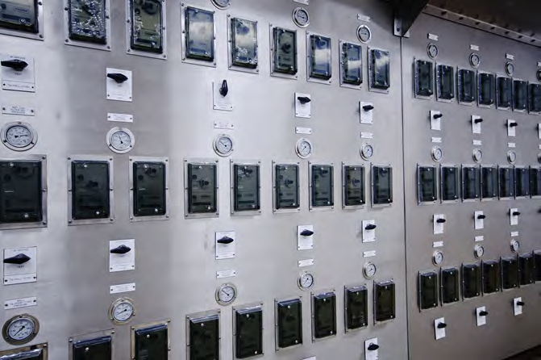

Module: Wellhead Control Panel

Slide 12
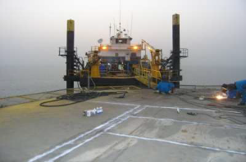
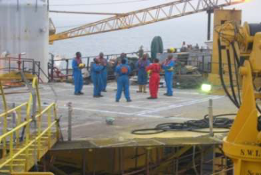
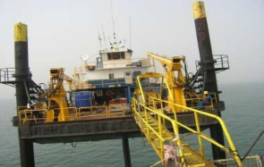
Offshore Construction

Slide 13
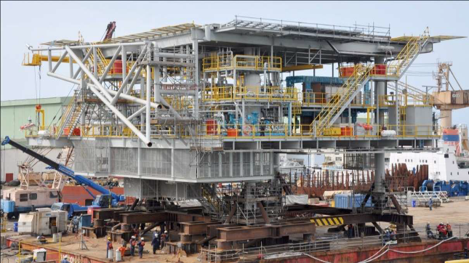
Module Fabrication

Slide 14
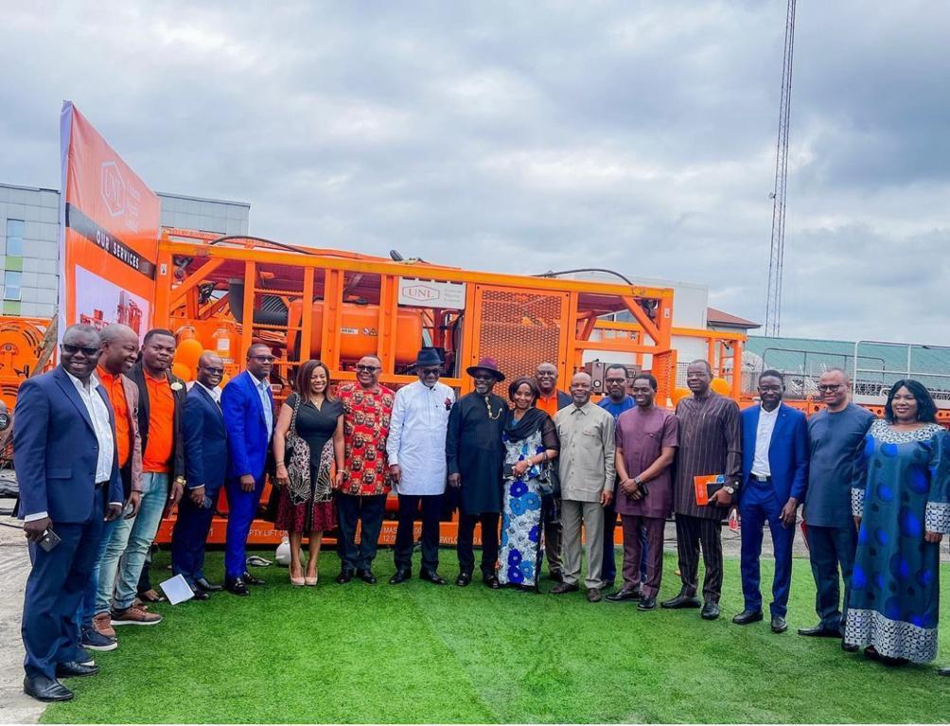
Commissioning of one OF our MEMBER’S facilities

Slide 15
CONCLUSION
Organised local service companies critical to the oil and gas industry support services.
Developing and patronising local service providers cost effective on the long run
Local Content law and guidelines catalyst to the value chain development and wealth domestication to
increase the GDP of the country.
Existence of local content development, monitoring and evaluation agency essential to maximise the benefits
of the Local Content Law and Guidelines.
Collaboration between all stakeholders in the industry important for the growth of the industry .
Regional collaboration between African service providers association will accelerate capacity development,
technology domestication and human capital development.

Slide 16
Thank You
For more information:
www.petan.org
secretariat@petan.org

